Slide 1
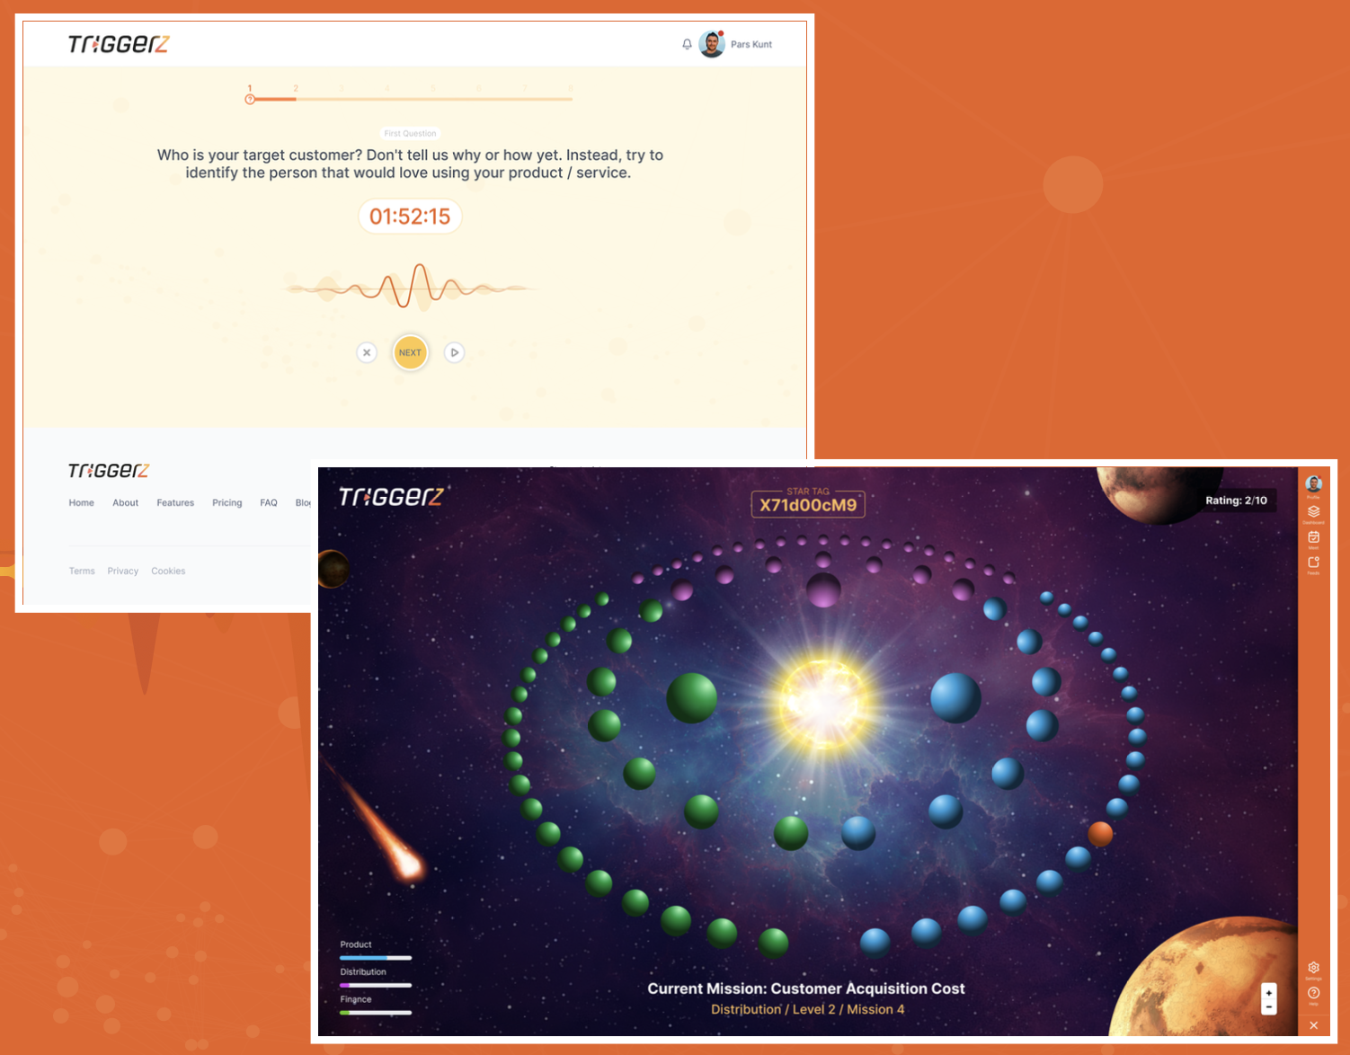
Voice triggered idea management web-app for Gen-Z

Slide 2
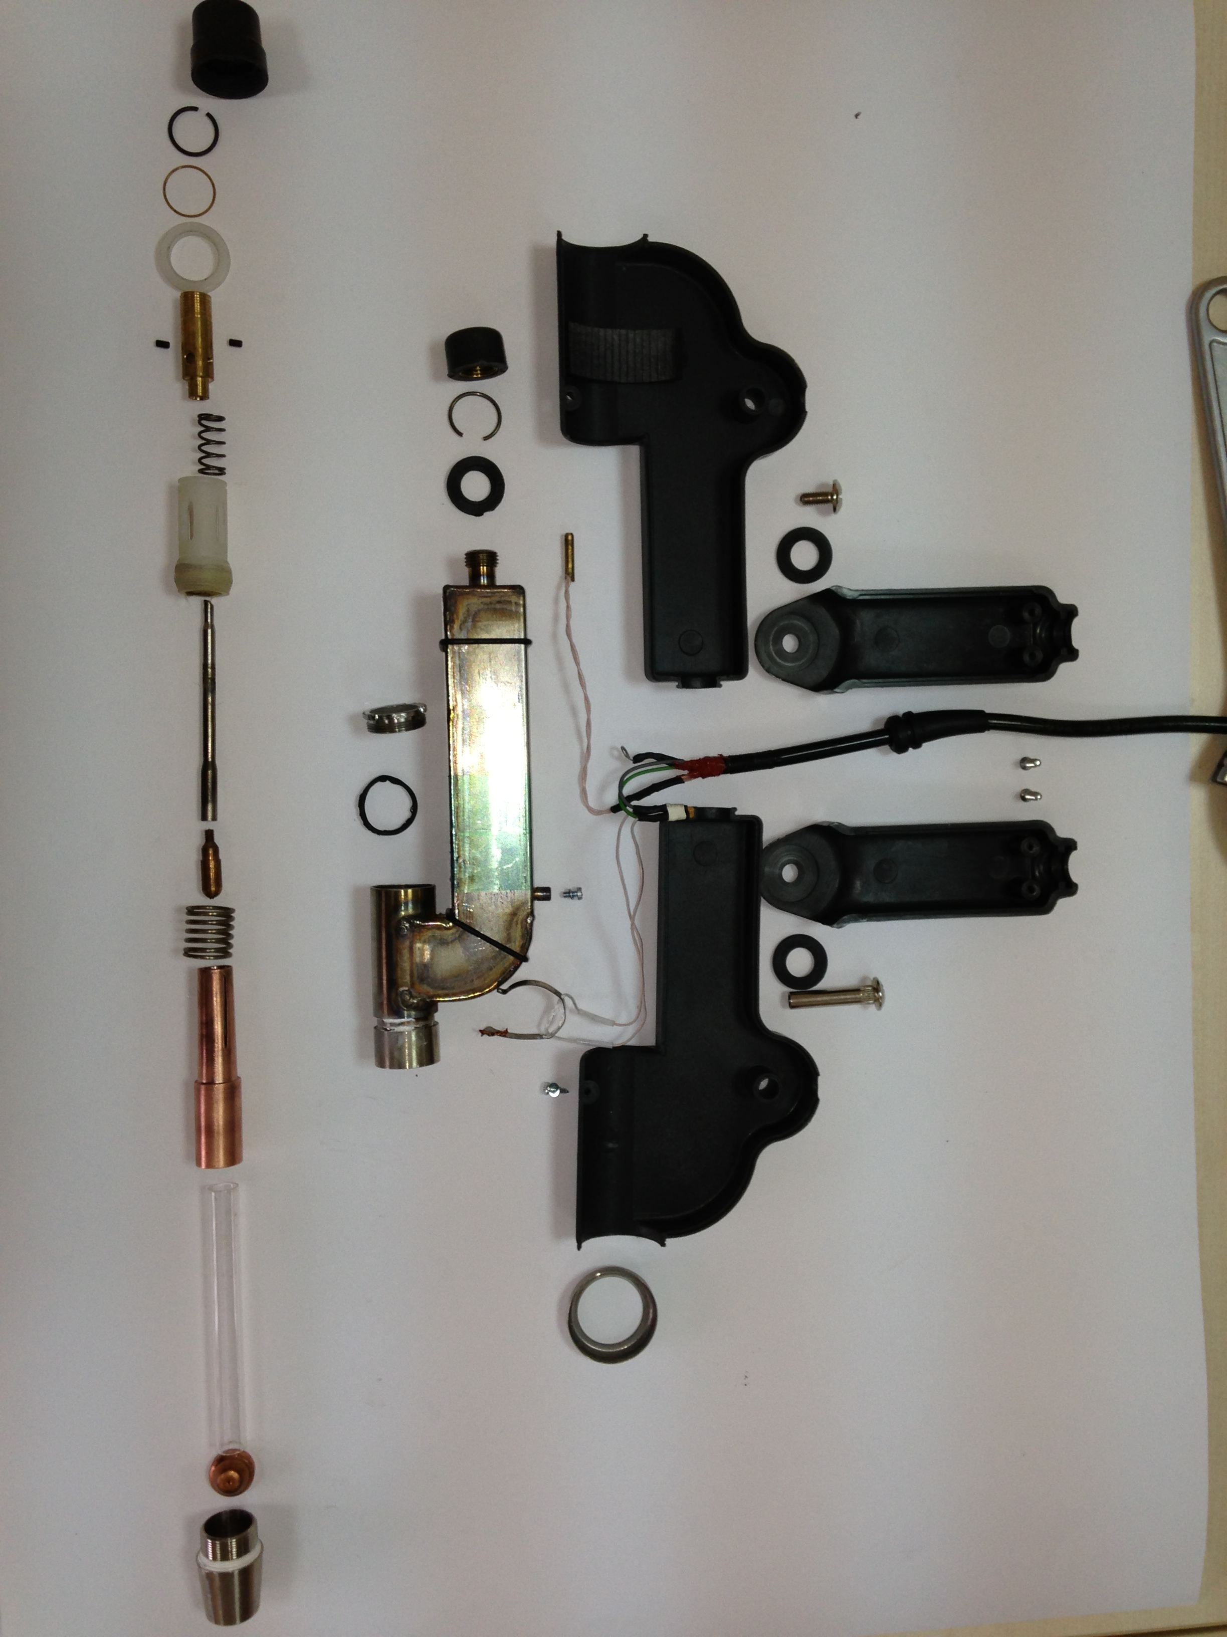
An all-purpose DC Arcjet Plasmatron Development

Slide 3
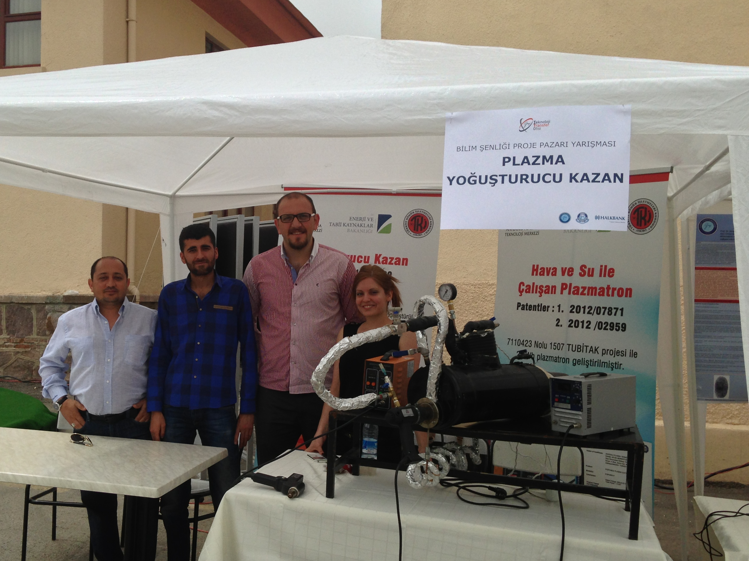
Plasma-condensed boiler for home-use

Slide 4
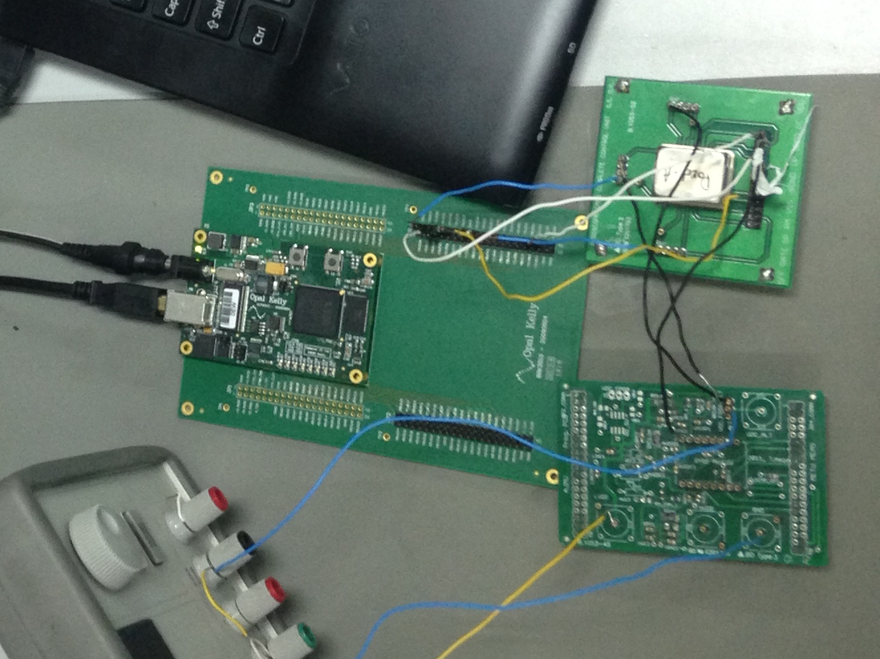
Low-noise MEMS accelerometer test setup

Slide 5
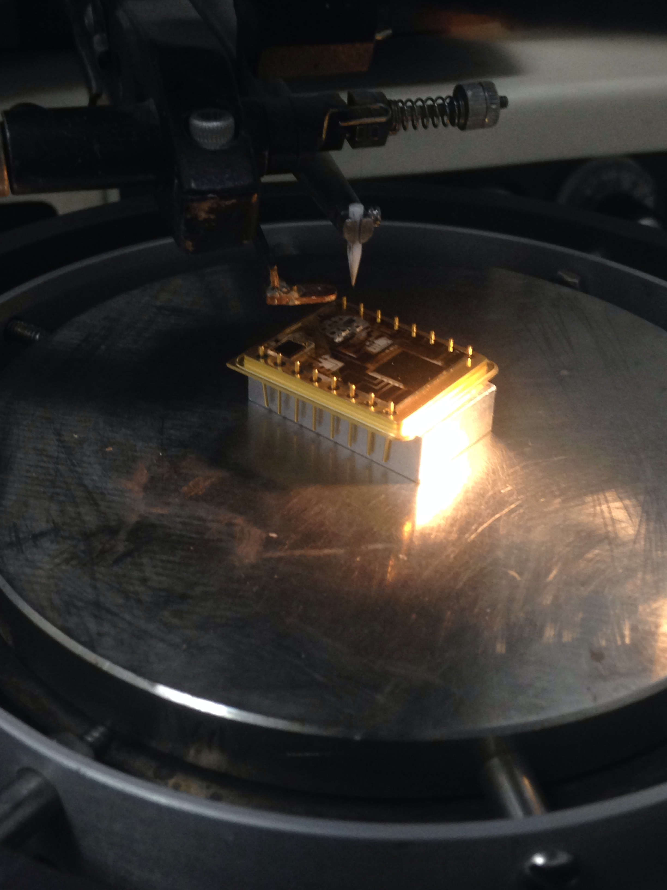
Package-level MEMS accelerometer + readout wiring

Slide 6
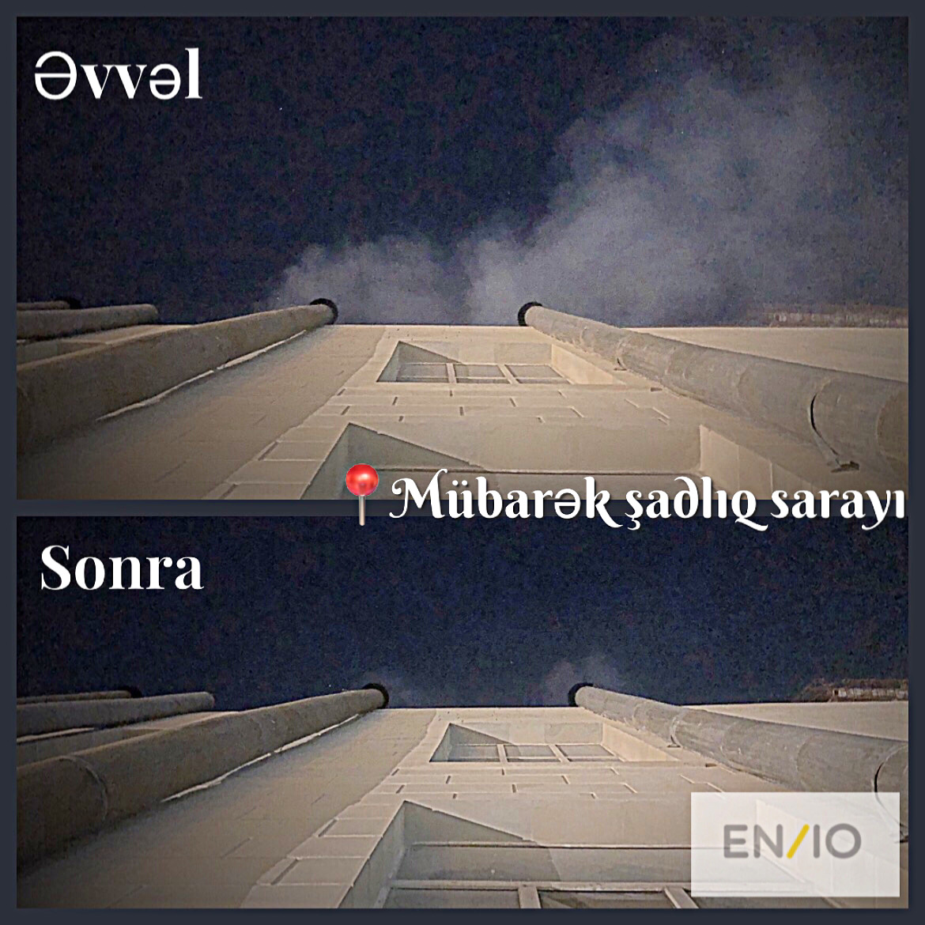
Application of electrostatic filters for grease air filtration

Slide 7
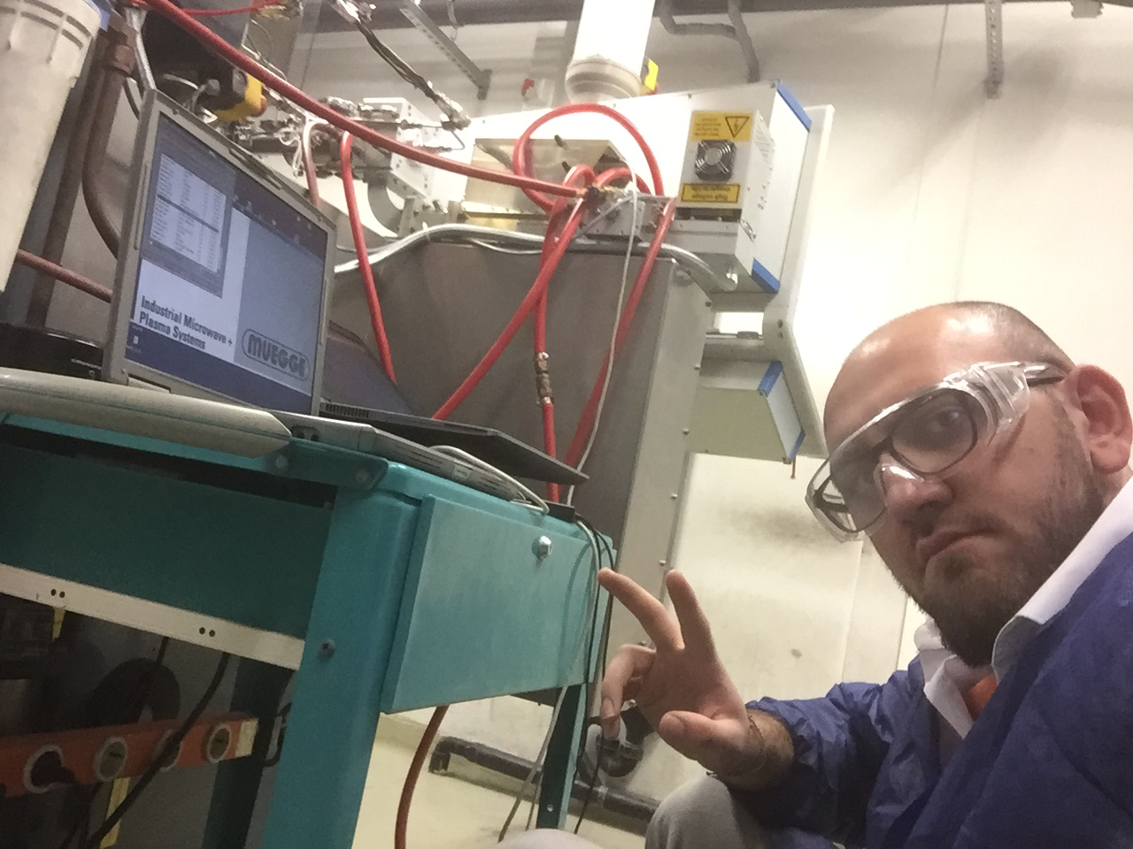
Microwave plasma application for fiber-optics production

Slide 8
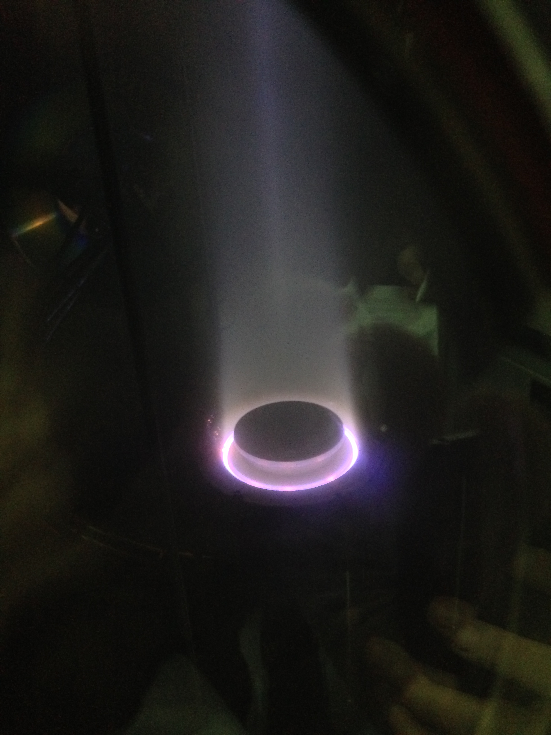
Hall-effect plasma thruster for mid-range satellites

